Slide 1
Parallel Programming
Final Presentation
Topic : K-Means clustering parallelization
110590007 PAI CHEN-AN

Slide 2
Directory
K-Means clustering
OUTLINE
Introduction
Implementation
Environment
Experiments
Profiling
Conclusion

Slide 3
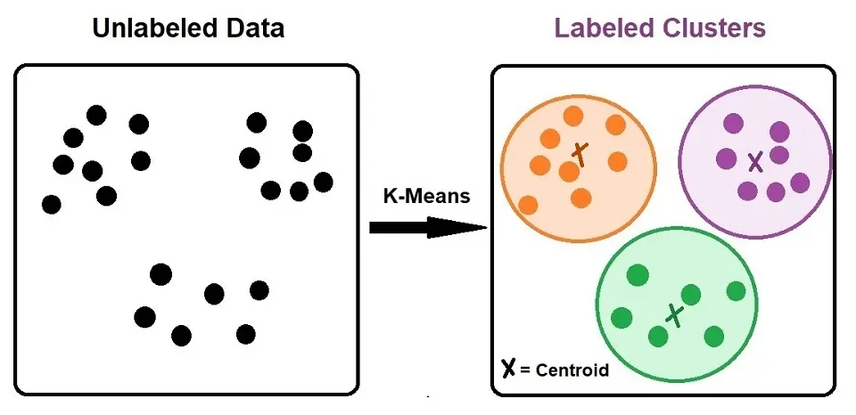
K-Means Introduction
Introduction
K-Means clustering is a popular unsupervised machine learning algorithm used for partitioning a dataset into K distinct, non-overlapping clusters (subsets).
The goal of the K-Means algorithm is to assign each data point to one of K clusters.
https://www.ejable.com/tech-corner/ai-machine-learning-and-deep-learning/k-means-clustering/

Slide 4
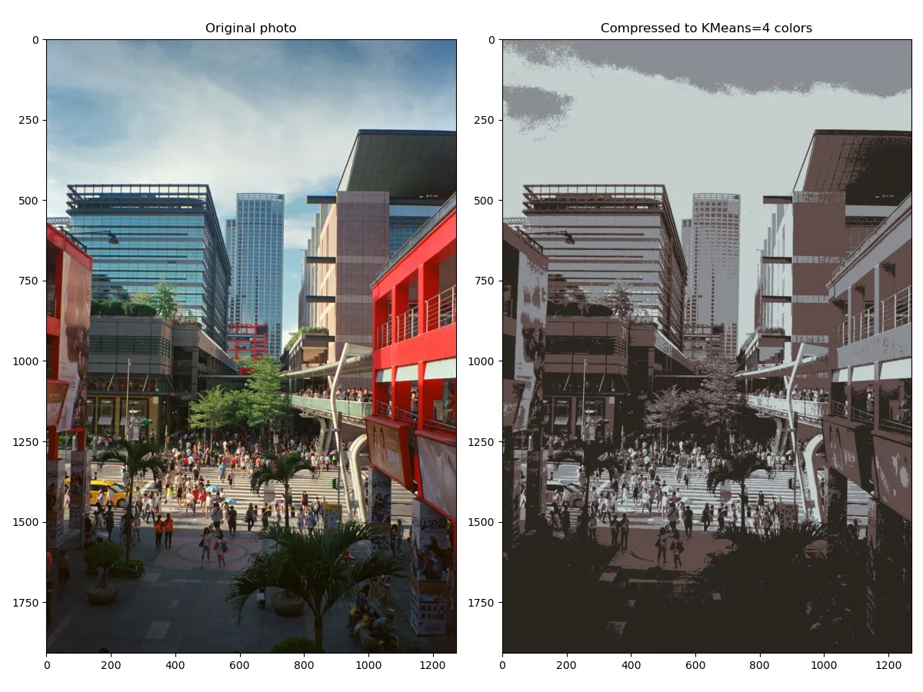
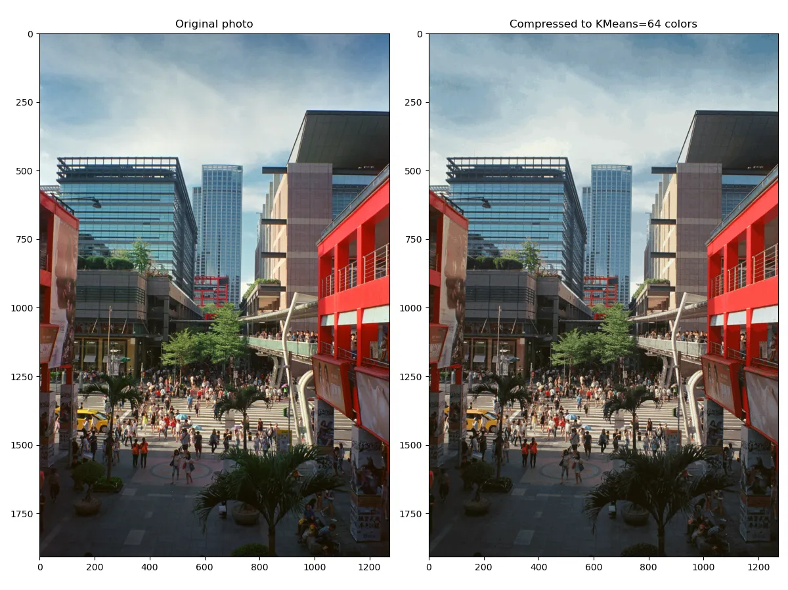
K-Means application
Introduction
Image compression :
origin：1.83 MB
K=64：390 KB
K=4：330 KB
K = 4
K = 64
https://alankrantas.medium.com/kmeans-能從資料中找出-k-個分類的非監督式機器學習演算法-所以它到底有啥用-使用-scikit-learn-與-python-5dd8c0c8b167

Slide 5
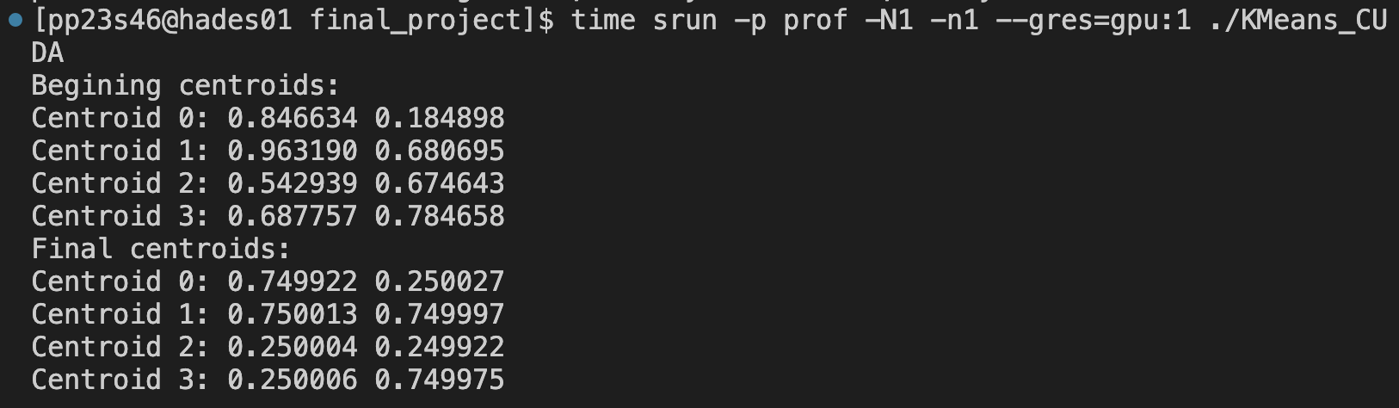
K-Means
Introduction
Implement K-Means clustering algorithm that outputs the final centroids position(can be >2D), with the assignments array storing points for each cluster.

Slide 6
Algorithm
Implementation
Initialization: Choose K initial cluster centroids randomly from the data points. These centroids represent the initial cluster centers.
Assignment: Assign each data point to the cluster whose centroid is closest in terms of distance. Commonly used distance metrics include Euclidean distance or Manhattan distance.
Update: Recalculate the centroids of the clusters based on the newly assigned data points. The centroid is the mean of all the data points in a cluster.
Repeat: Repeat steps 2 and 3 until convergence. Convergence occurs when the assignment of data points to clusters and the recalculation of centroids no longer result in significant changes.

Slide 7
3 Implementations
Implementation
Sequential version
OpenMP version
CUDA version

Slide 8
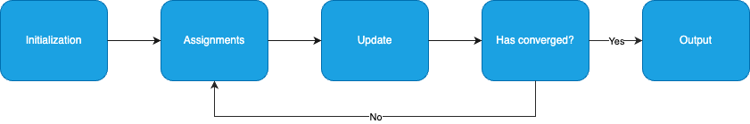
Sequential version
Implementation
Initialization : use random() to generate dataset, with random seed srand(42) used.
Has converged : set threshold to 0.0001. when the update of centroids from last position to current position is lower than threshold, stop the loop.
Output : output the centroid of each cluster.

Slide 9
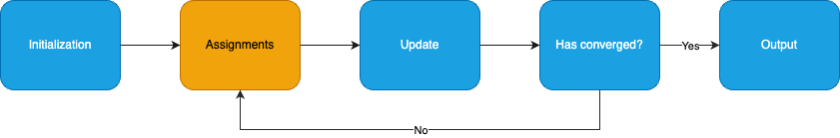
OpenMP version
Implementation
Assignments function : has no data dependency between each data point, so it can be parallelized by using “#pragma omp parallel for “
Update function : has dependency when calculate the size and the sum of each cluster, so this cannot be parallelized.

Slide 10
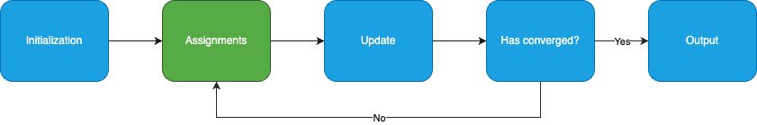
CUDA version
Implementation
Assignments function : launch GPU kernel to do the assignment. Partition the data evenly. Flatten the sequential computation that each data point uses one thread in GPU.
Update function : Since there are dependencies when calculating the size and the sum of each cluster, so put the calculation of update part back to CPU.

Slide 11
Experiment environment
Environment
All the experiments were done in Hades machine.
Using the following sbatch config :
#SBATCH --job-name=kmeans_job
#SBATCH --nodes=1
#SBATCH --ntasks=1
#SBATCH -c 2
#SBATCH --gres=gpu:1
#SBATCH --output=output.log
#SBATCH --error=error.log

Slide 12
compile flag & library
Environment
compile flag :
CC = gcc
CFLAGS = -O3 -march=native
MPFLAGS = -fopenmp
LDFLAGS = -lm
NVCC = nvcc
NVCCFLAGS = -std=c++11 -O3 -Xptxas="-v" -arch=sm_61
XCOMPILERFLAGS = -Xcompiler
library : nvhpc23.3

Slide 13
Experiments testcases
Experiments
According to different computing behaviors, two different types of testcases are defined.
Type 1 : simulates the situation of having many data points, with smaller data dimension, and less centroids number(less K).
Type 2 : simulates the situation of having less data points, but each data point has higher dimension, and more centroids(many K).

Slide 14
Experiments testcases
Experiments
Type 1 :
#define numPoints 150000000
#define numDimensions 2
#define numCentroids 4
#define maxIterations 50
#define convergenceThreshold 0.0001
Type 2 :
#define numPoints 10000
#define numDimensions 256
#define numCentroids 1024
#define maxIterations 50
#define convergenceThreshold 0.0001

Slide 15
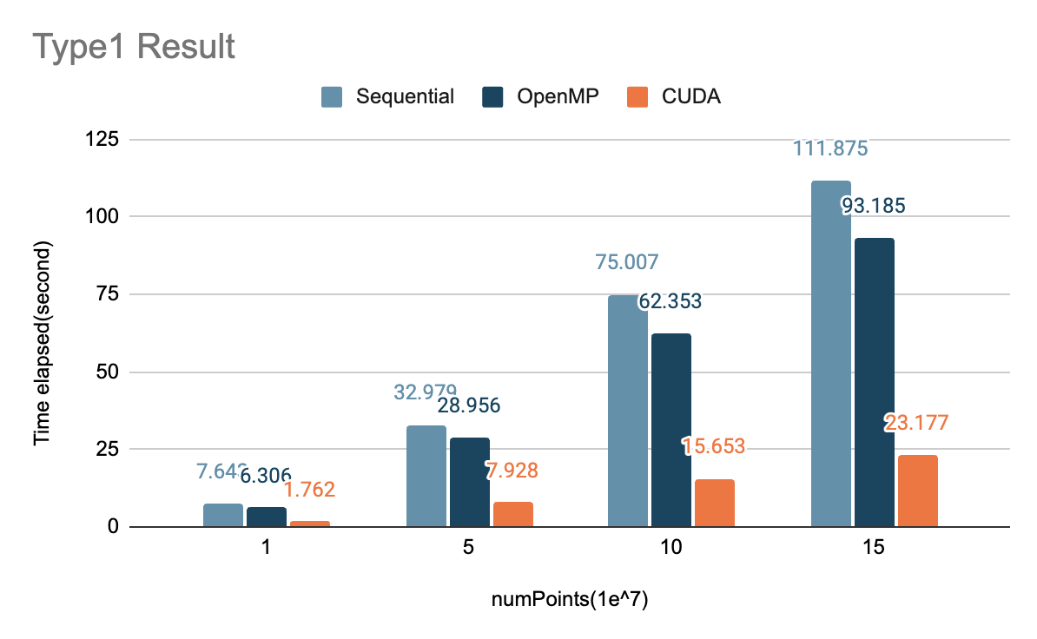
Type1 scalability
Experiments

Slide 16
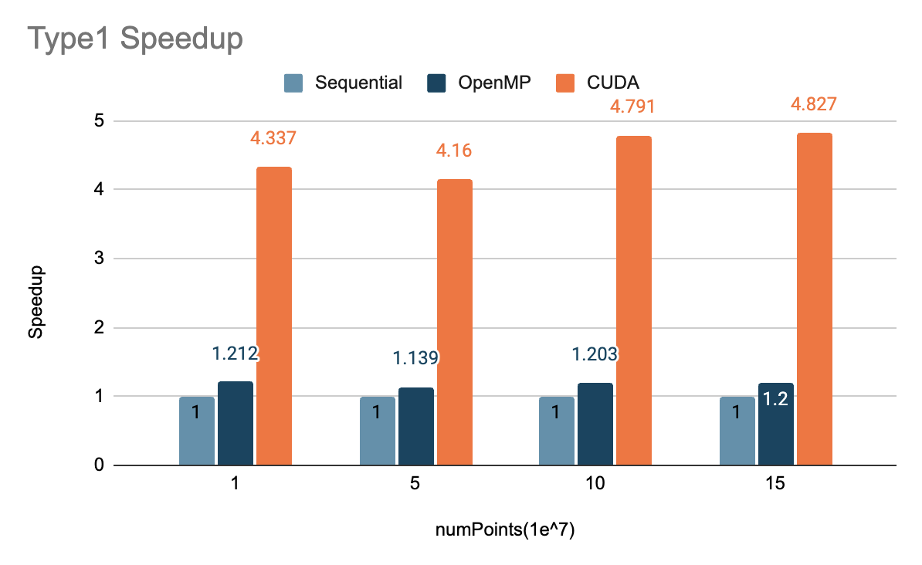
Type1 Speedup
Experiments

Slide 17
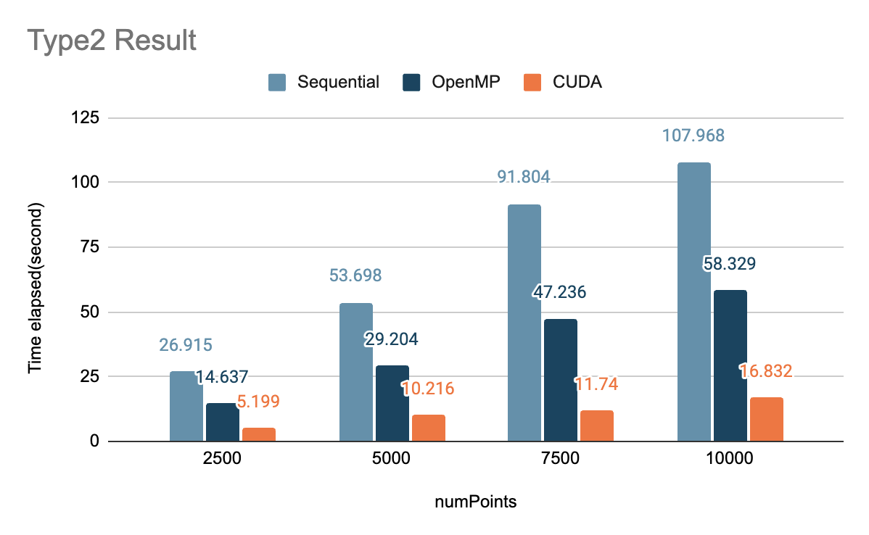
Type2 scalability
Experiments

Slide 18
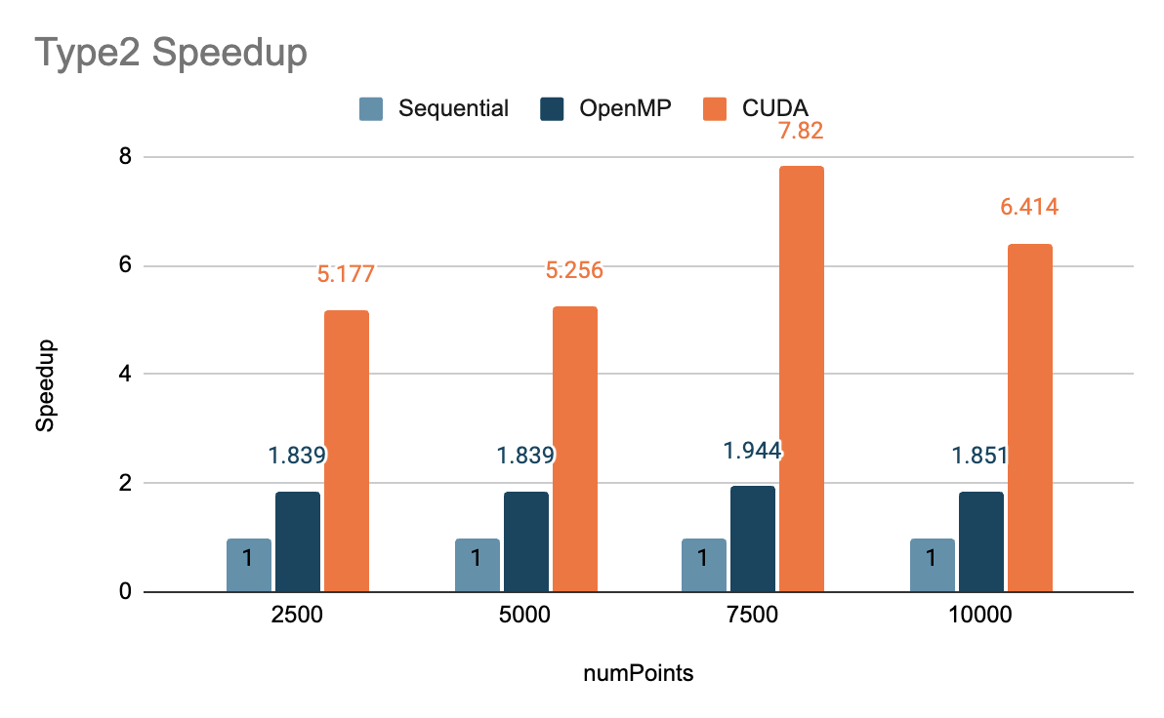
Type2 Speedup
Experiments

Slide 19
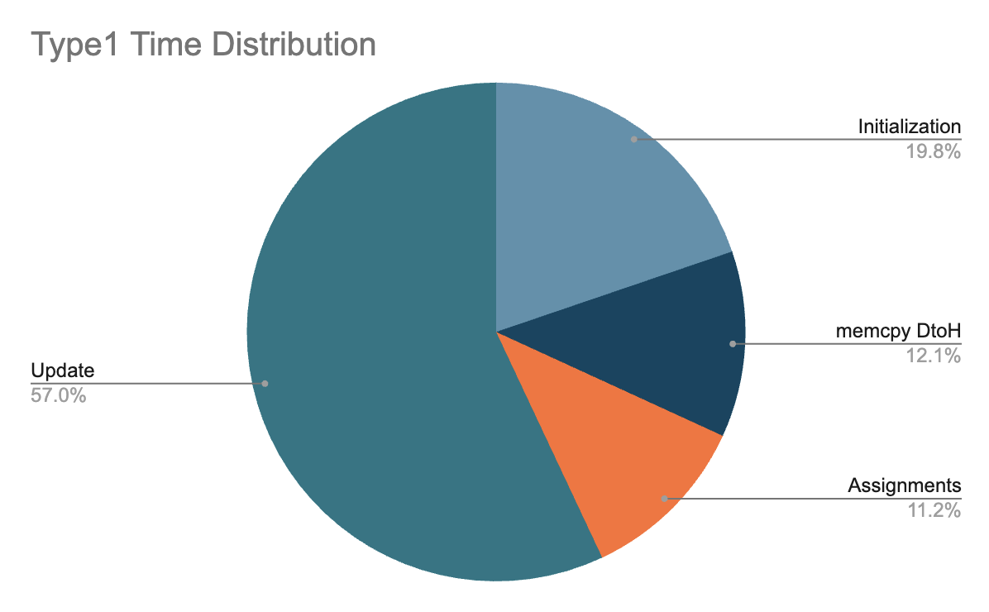
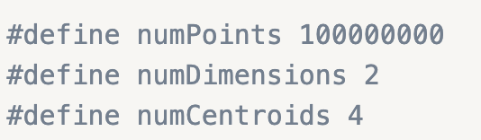

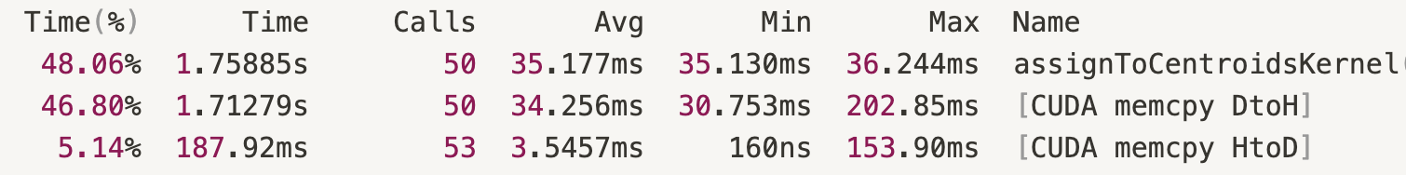
Type1 Time Distribution
Profiling
total : 16.308s

Slide 20
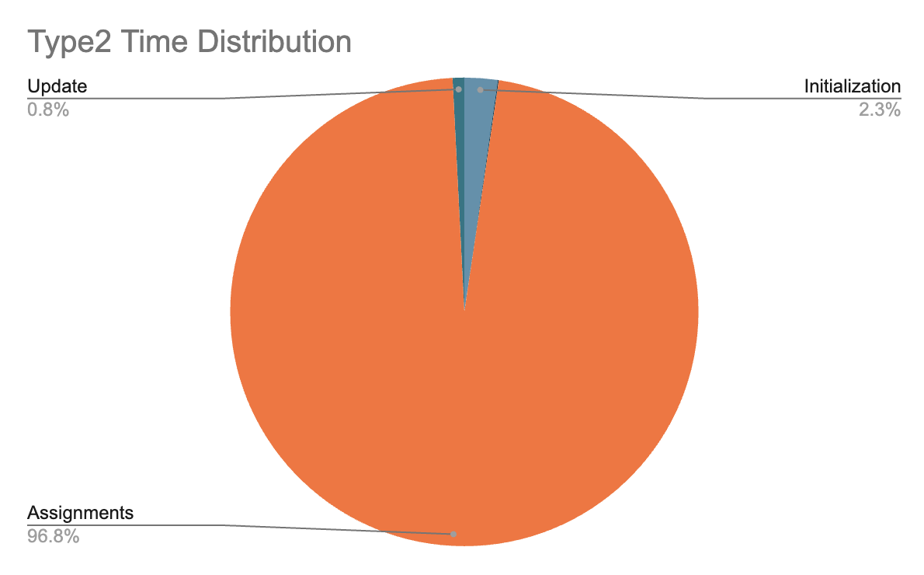
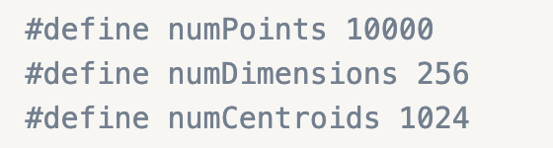
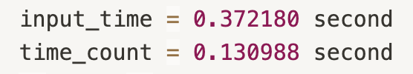
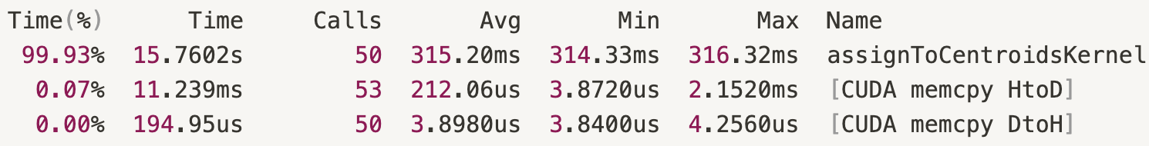
Type2 Time Distribution
Profiling
total : 16.533s

Slide 21
Analysis of stages
Analysis
Initialization : If there are more data points, it will take more time to initialize, and more time to do the memory copy.
Update : The time for Update stage will be bounded by O(numPoints) or O(numCentroids * numDimension). The larger of the two will dominate the update execution time(generally, the former will dominate).

Slide 22
Analysis of stages
Analysis
3. Memory Copy : Each iteration requires moving the assignments array(DtoH) and centroids array(HtoD).
The assignments array is the dominate item for memory copy, because generally speaking, the number of data points must be greater than the number of clusters (otherwise it would be unreasonable).

Slide 23
Analysis for Type1
Analysis
Type1 : higher numPoints, lower numDimension and numCentroids
Initialization : more data points, more time spend to initialized.
Memory copy : more data points, more time spend to memory copy.
Update : dominate by the numPoints.
=> result in low GPU utilization, so the speedup of CUDA version is a less than type2.

Slide 24
Analysis for Type2
Analysis
Type1 : lower numPoints, higher numDimension and numCentroids
Initialization : less data points, less time spend to initialized.
Memory copy : less data points, less time spend to memory copy.
Update : dominate by the numPoints.
=> result in high GPU utilization, so the speedup of CUDA version is higher

Slide 25
Conclusion
Conclusion
The K-Means implementation can meet different scenario, whether many data points or high data dimension and many K.
The parallelization using CUDA and OpenMP have a decent boost in performance.
Further improvement can be done for Update stage.

Slide 26
Thanks for watching!

